Slide 1



Hydrogen Production and Storage in CaTiO₃ Perovskite at Mantle-Related High Pressures
Ava Campbell
18 April 2026
AZ NASA Space Grant
Statewide Student Research Symposium
Advisor: Dr. Sang-Heon Dan Shim

Slide 2

Introduction
CaTiO₃ perovskite is known to split water into H₂ and O₂ using UV light as a catalyst at 1 bar (Passi and Pal, 2021)
Preliminary experiments indicate that heat can replace UV light at high pressures
∆
CaTiO₃ → CaTiO_{2.5} + 0.25 O₂
CaTiO_{2.5} + 0.5 H₂O → CaTiO₃ + 0.5 H₂

Slide 3
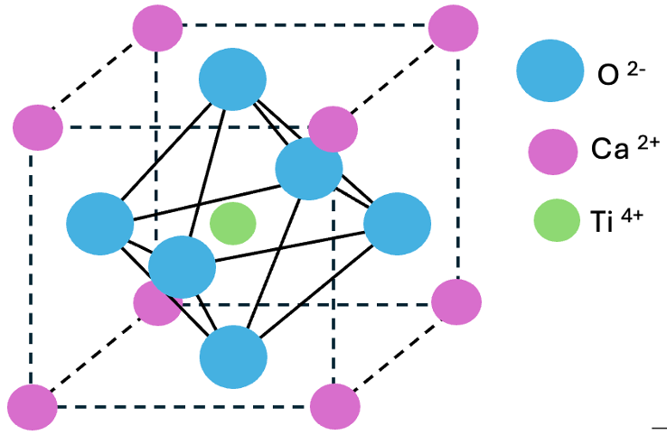




Introduction
CaTiO₃ perovskite is known to split water into H₂ and O₂ using UV light as a catalyst at 1 bar (Passi and Pal, 2021)
Preliminary experiments indicate that heat can replace UV light at high pressures
PT
∆
CaTiO₃ → CaTiO_{2.5} + 0.25 O₂
CaTiO_{2.5} + 0.5 H₂O → CaTiO₃ + 0.5 H₂

Slide 4

Introduction
For CaTiO₃ perovskite to split water:
Ti’s ability to change oxidation states
Crystal Structure
For Fe-bearing MgSiO₃ and CaSiO₃ perovskites:
Fe’s ability to change oxidation states
Crystal Structure

Slide 5
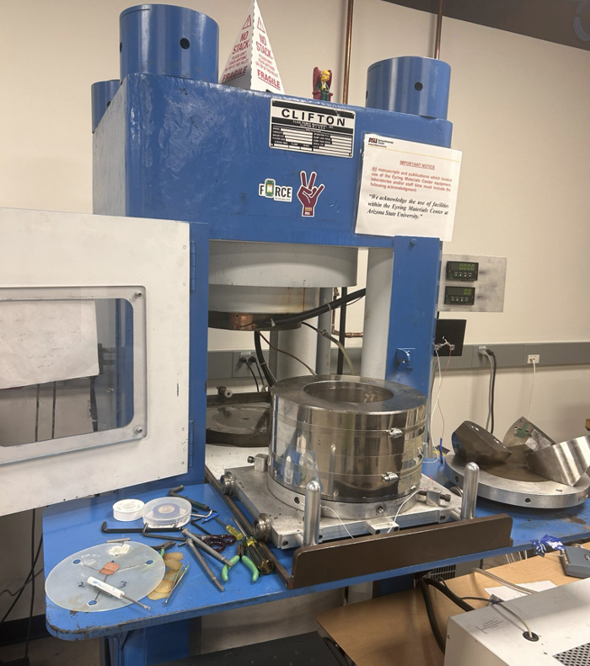
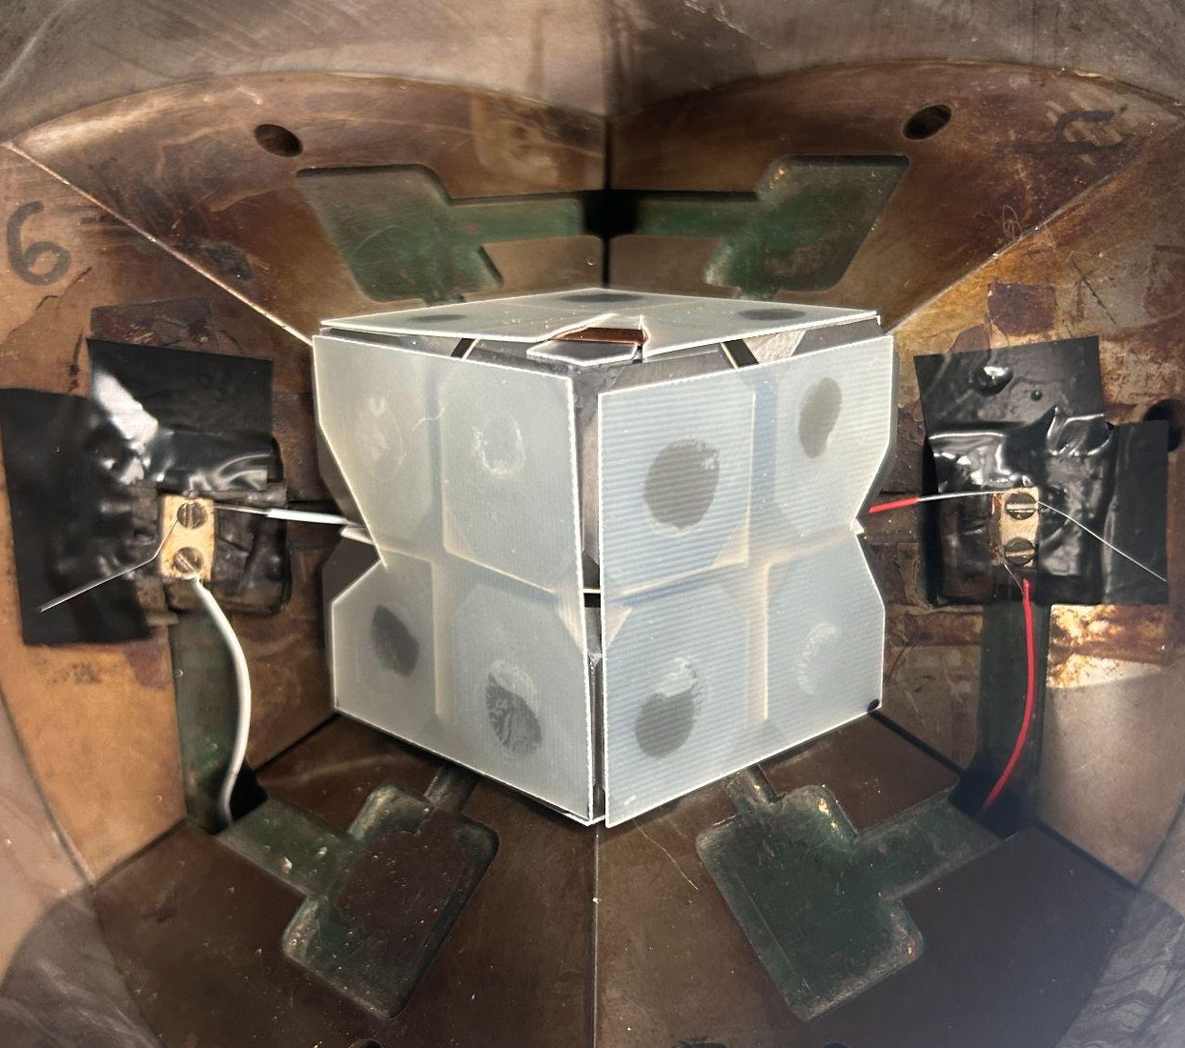
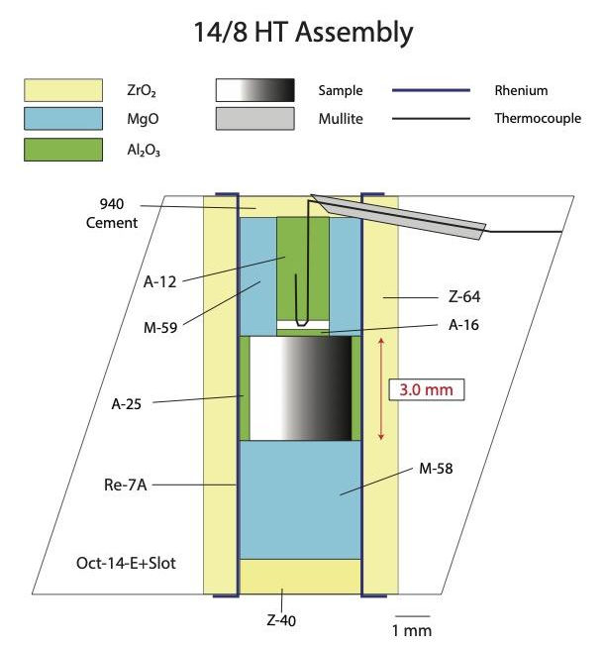
Methods – High-Pressure Experiments
1 in
Assembly used for experiments. Sample is loaded into a welded
Pt capsule.
Assembly inside 8 tungsten-carbide cubes and connected to thermocouple (red and white wires) to measure temperature.
“Big Blue” ASU’s 1100-ton multi-anvil press

Slide 6
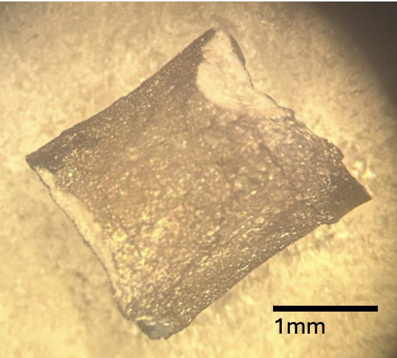
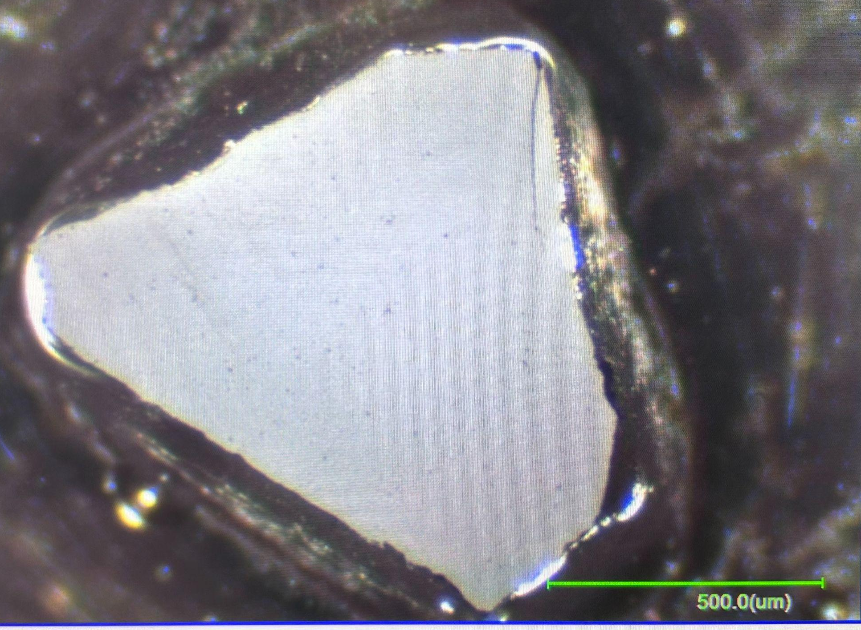

Methods – Spectroscopic Analysis
MgO from assembly
H₂ stretching vibration
sample
capsule
Raman and IR are vibrational spectroscopy techniques. These measure the H-H bond (along with others such as O-H)
Recovered sample capsule. Capsule is cut in half (red dotted line) and Raman is measured in the middle of the sample.
A piece of sample is removed from the recovered sample capsule and double polished to 100 micron thickness to prepare it for IR measurements.

Slide 7
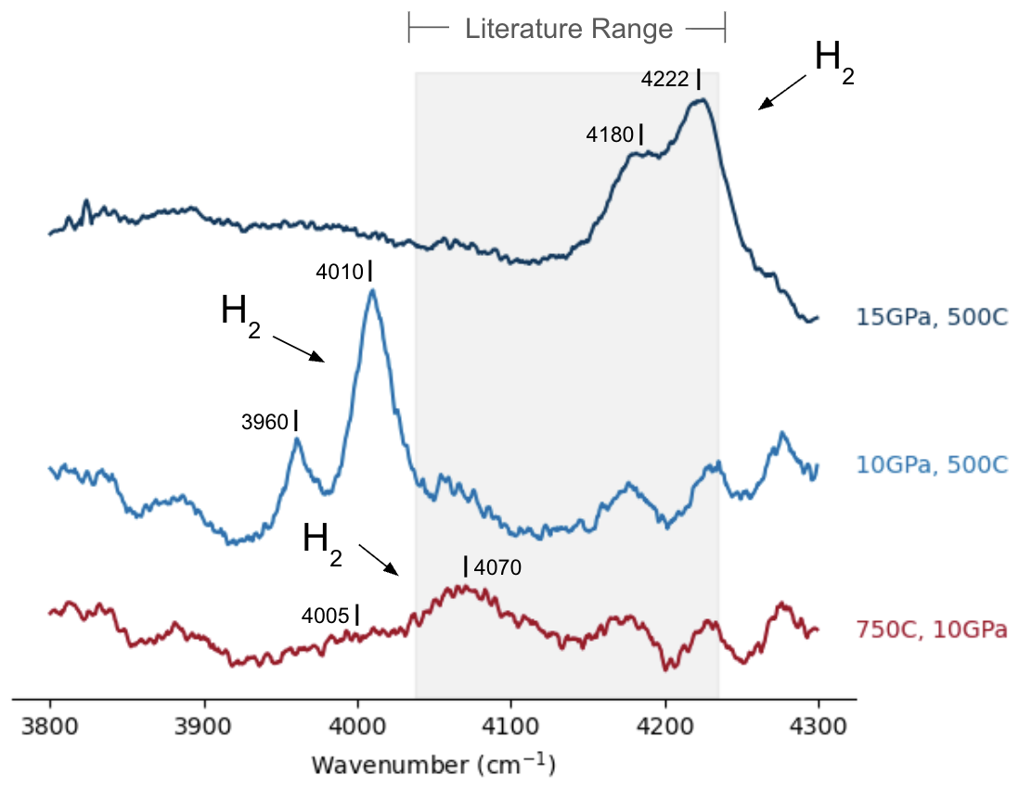
Results and Discussion – Raman H₂ Band Shifting
H₂ peak separation of
15 GPa sample: 42 cm⁻¹
10 GPa sample: 50 cm⁻¹
750 C sample: 65 cm⁻¹

Slide 8
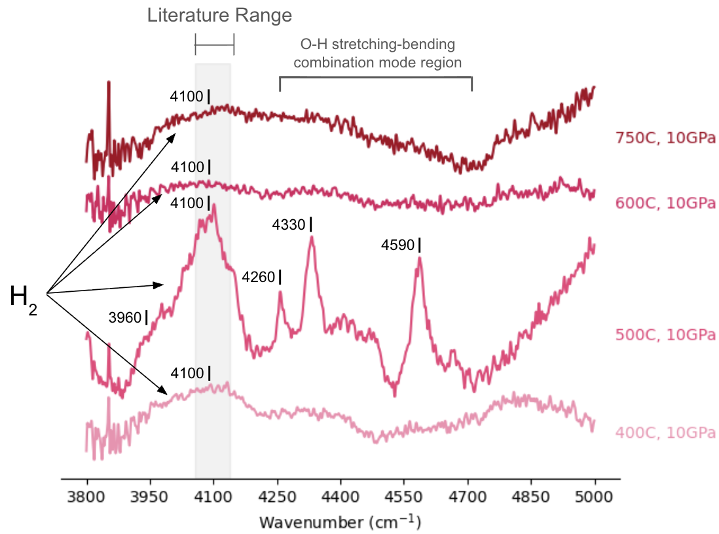
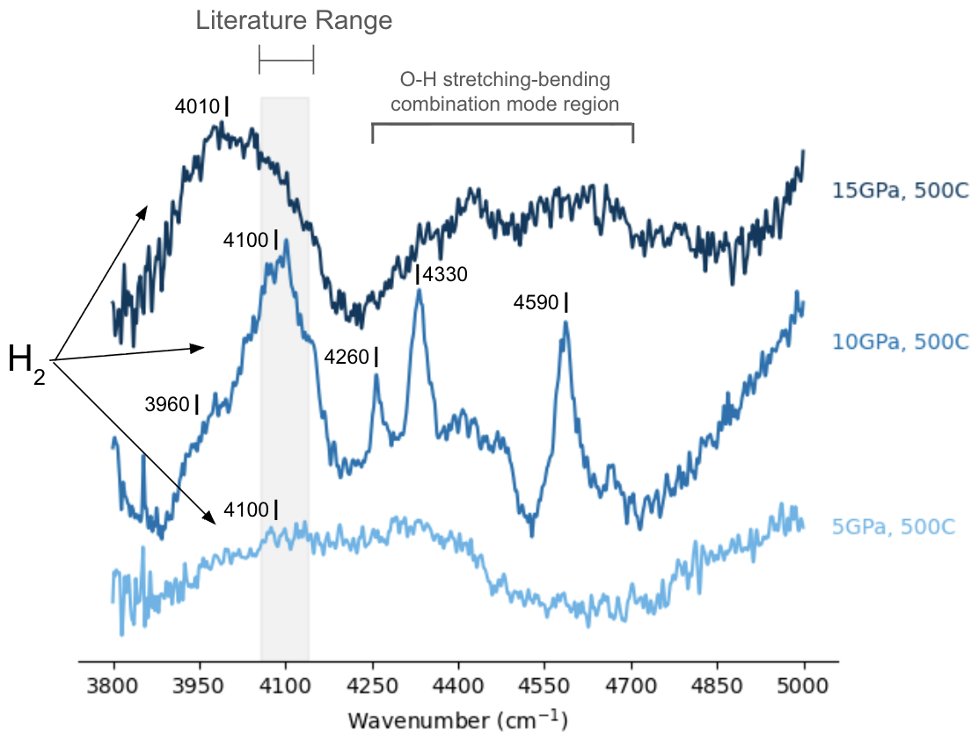
Results and Discussion – IR H₂ Band Shifting
O-H stretching-bending combination modes tend to occur ≥4200 cm⁻¹ (Ohlhorst et al., 2001; Bishop et al., 2002; Efimov, 2003; Wu et al., 2021)

Slide 9
Discussion – H₂ Storage vs H₂O Splitting
Across all samples, the 10GPa/500C sample has the most intense H₂ band in both Raman and IR
The 10GPa/500C PT condition maximizes both water splitting and H₂ storage efficiency
water splitting or H₂ storage efficiency
10GPa, 500C
water splitting or H₂ storage efficiency
P/T
P/T

Slide 10
Conclusion
This work varied the synthesis PT conditions for the CaTiO₃ water splitting reaction and subsequent H₂ storage within the CaTiO₃ crystal structure.
Based on the H₂ peak shifting in both Raman and IR, we interpret that the preferred crystallographic site of H₂ in CaTiO₃ perovskite changes based on the pressure and temperature conditions.

Slide 11
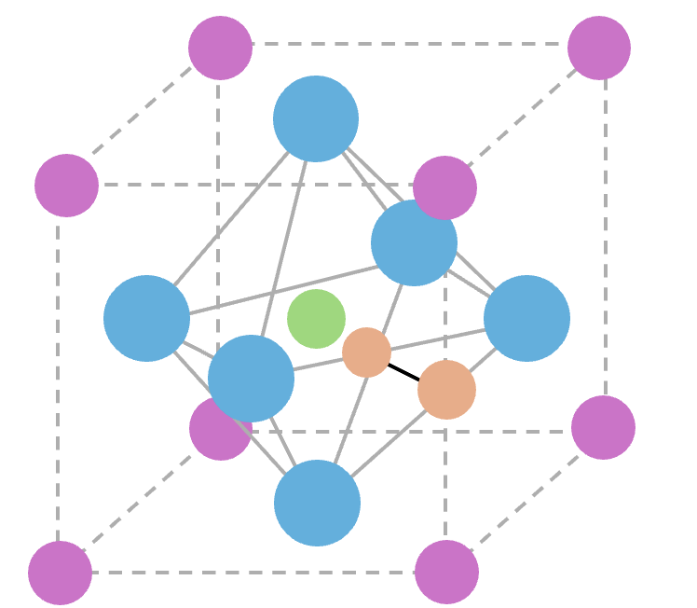
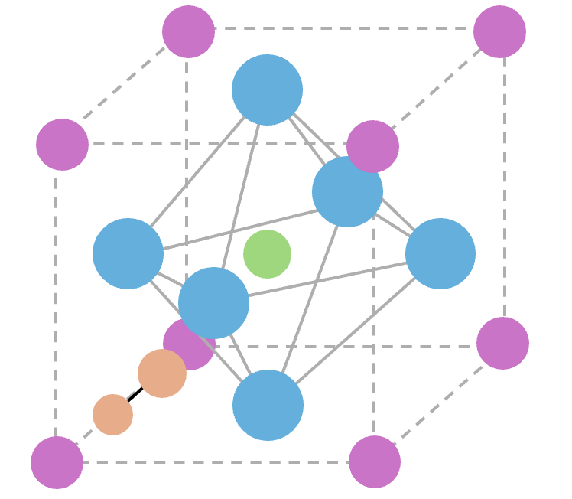
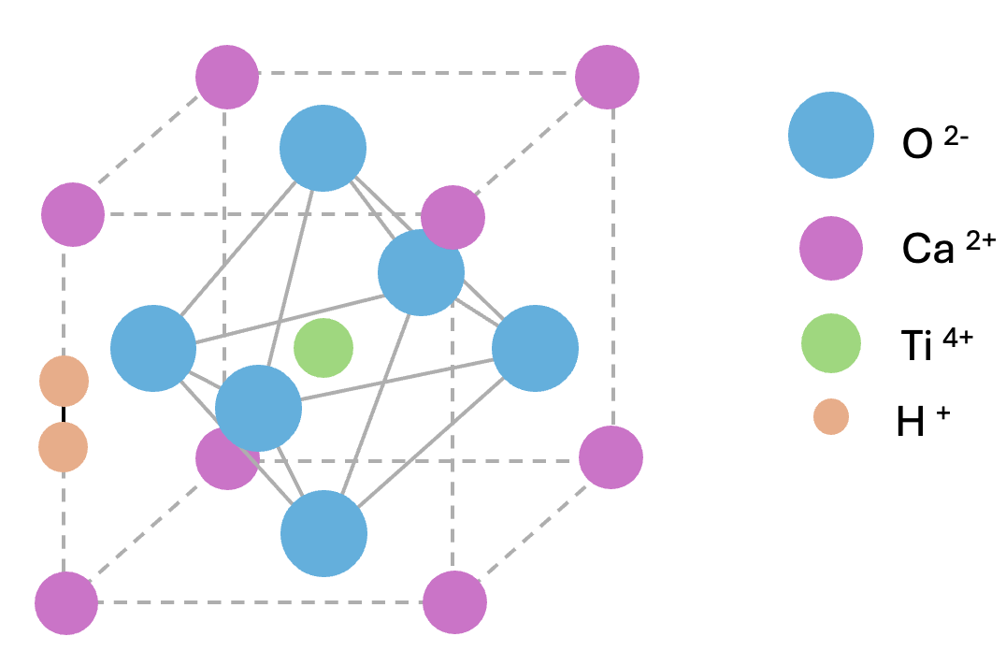
Conclusion
This work varied the synthesis PT conditions for the CaTiO3 water splitting reaction and subsequent H2 storage within the CaTiO3 crystal structure.
Based on the H₂ peak shifting in both Raman and IR, we interpret that the preferred crystallographic site of H₂ in CaTiO₃ perovskite changes based on the pressure and temperature conditions.

Slide 12
Future Work
In situ IR measurements while heating
Determine if observed peaks at higher wavenumbers are associated with H₂ or some OH-related band
Computational work to calculate crystallographic site and corresponding Raman/IR signal
Calculated spectra can provide a better understanding of how the preferred crystallographic site of H₂ changes with pressure and temperature

Slide 13
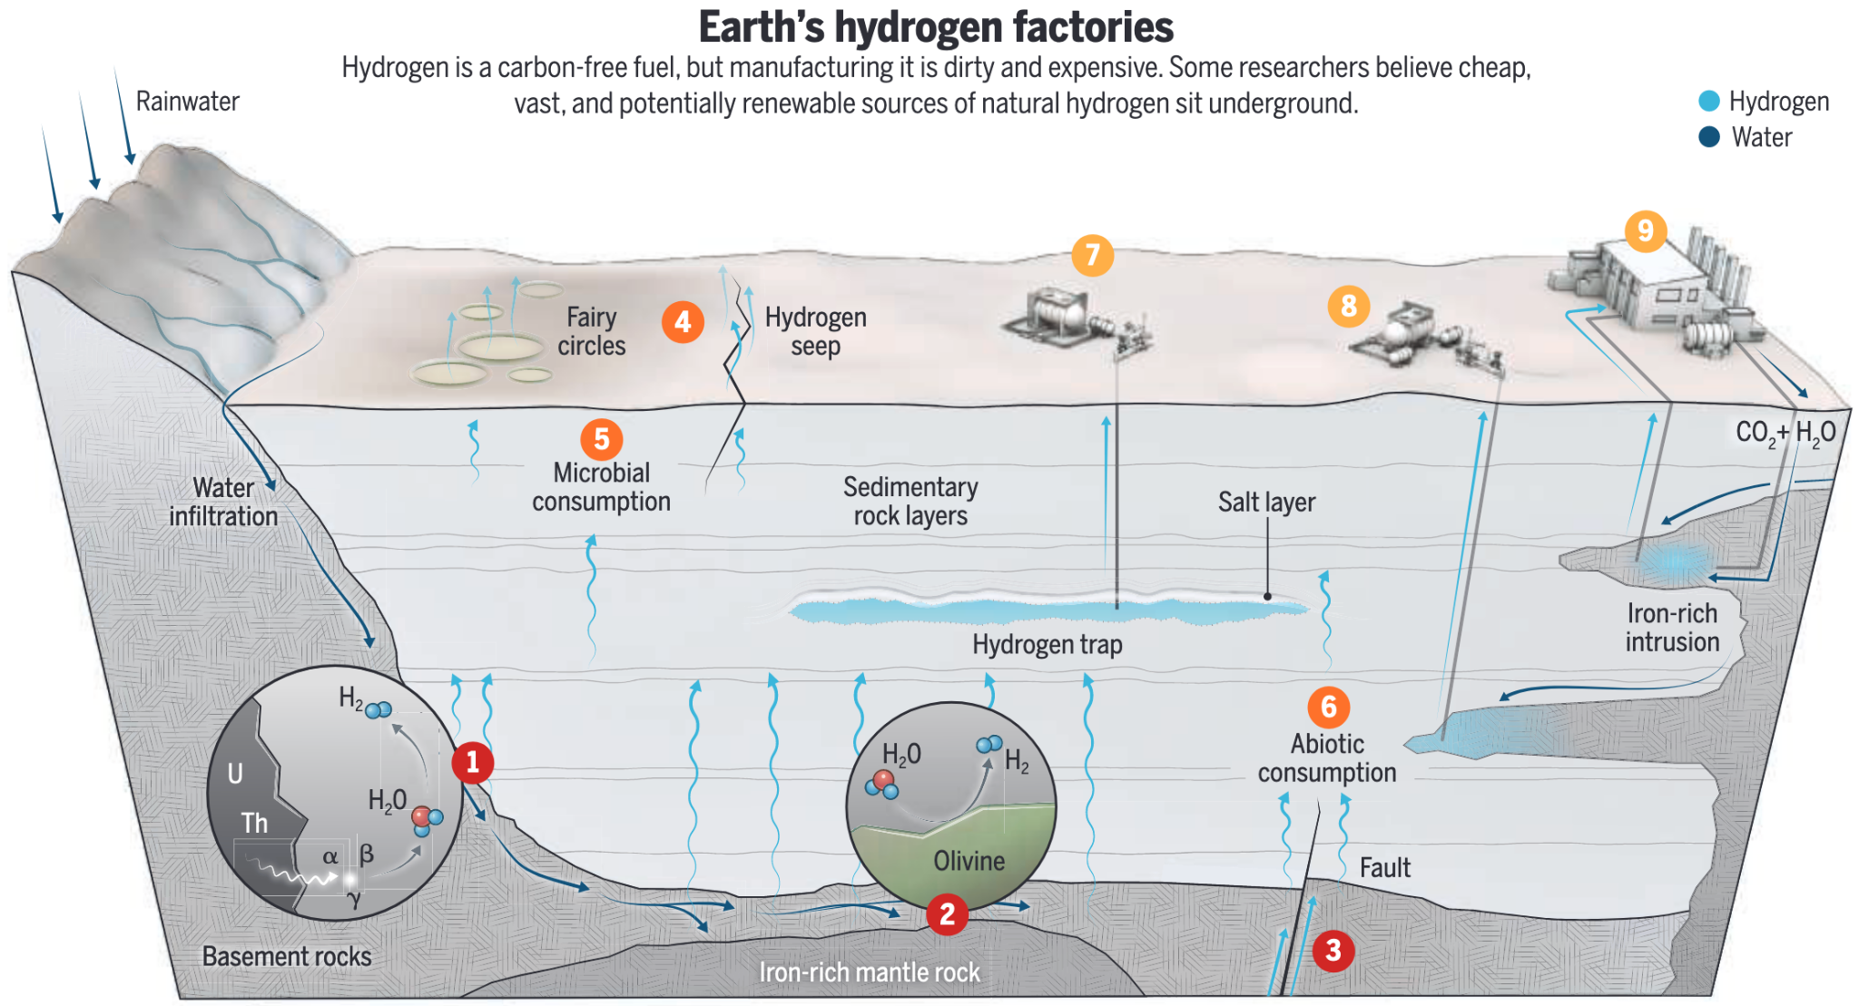
Geologic Implications
H₂O
H₂
CaTiO₃
+ H₂
Hand (2023)

Slide 14
Acknowledgements
I would like to thank Dr. Shim for advising and guiding me in this project; Dr. Shock for providing his expertise and support in this project; Drs. Chen and Kim for training me on high-pressure techniques, including multi-anvil press and Raman; Dr. Shim’s lab group for listening and providing feedback and support for not only this presentation, but this project over the last 2 years; FORCE facility for use of their multi-anvil press and support in training me; Eyring Materials Center for training on and use of their IR; and NASA Space Grant for providing financial support and opportunities to present this work in a variety of settings

Slide 15
References
Bishop, J.; Murad, E.; Dyar M. D. The Influence of Octahedral and Tetrahedral Cation Substitution on the Structure of Smectites and Serpentines as Observed through Infrared Spectroscopy. Clay Miner. 2002, 37 (4), 617–628. https://doi.org/10.1180/0009855023740064.
Efimov, A. M.; Pogareva, V. G.; Shashkin, A. V. Water-Related Bands in the IR Absorption Spectra of Silicate Glasses. J. Non-Cryst. Solids 2003, 332 (1), 93–114. https://doi.org/10.1016/j.jnoncrysol.2003.09.020.
Hand, E. Hidden Hydrogen: Earth may hold vast stores of renewable carbon-free fuel. Science. 2023, 379(6633). https://doi.org/10.1126/science.adh1460
Moine, B. N.; Bolfan-Casanova, N.; Radu, I. B.; Ionov, D. A.; Costin, G.; Korsakov, A. V.; Golovin, A. V.; Oleinikov, O. B.; Deloule, E.; Cottin, J. Y. Molecular Hydrogen in Minerals as a Clue to Interpret ∂D Variations in the Mantle. Nat. Commun. 2020, 11 (1), 3604. https://doi.org/10.1038/s41467-020-17442-8.
Ohlhorst, S.; Behrens, H.; Holtz, F. Compositional Dependence of Molar Absorptivities of Near-Infrared OH- and H2O Bands in Rhyolitic to Basaltic Glasses. Chem. Geol. 2001, 174 (1), 5–20. https://doi.org/10.1016/S0009-2541(00)00303-X.
Passi, M.; Pal, B. A Review on CaTiO3 Photocatalyst: Activity Enhancement Methods and Photocatalytic Applications. Powder Technol. 2021, 388, 274–304. https://doi.org/10.1016/j.powtec.2021.04.056.
Wu, S.; He, M.; Yang, M.; Zhang, B.; Wang, F.; Li, Q. Near-Infrared Spectroscopy Study of Serpentine Minerals and Assignment of the OH Group. Crystals 2021, 11 (9), 1130. https://doi.org/10.3390/cryst11091130.

